Slide 1

SUB: STOP-AND-WAIT ARQ.
NAME : MUKULI MONDAL
ROLL NO : 16800118002
DEPT : CSE
YEAR : 3RD

Slide 2
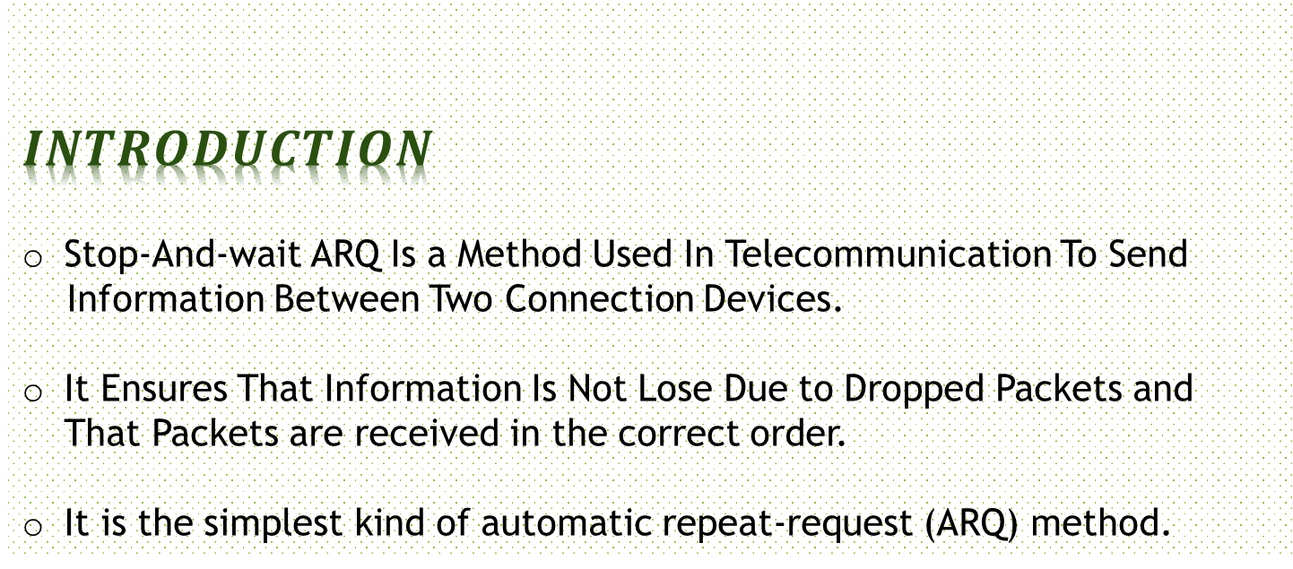
$$INTRODUCTION$$
Stop-And-wait ARQ Is a Method Used In Telecommunication To Send
Information Between Two Connection Devices.
It Ensures That Information Is Not Lose Due to Dropped Packets and That Packets are received in the correct order.
It is the simplest kind of automatic repeat-request (ARQ) method.

Slide 3
DESCRIPTION
A Stop-and-wait ARQ Sender Sends One Frame At A Time
It Is A Special Case Of The General Sliding Window Protocol With
Both Transmit And Receive Window Size Equal To 1
After Sending Each Frame. The Sender Doesn’t Send Any Further Frames Until It Receives An Acknowledgement(ACK) Signal
After Receiving A Good Frame. The Receiver Sends And ACK
If The ACK Does Not Reach The Sender Before A Certain Time. Known As The Timeout, The Sender Sends The Same Frame Again.

Slide 4
Typically The Transmitter Adds A Redundancy Check Number To The End Each Frame.
The Receiver Uses The Redundancy Check Number To Check For Possible Damage. If The Receiver Sees That The Frame Is Good, It Sends An ARQ.
If The Receiver Sees That The Frame Is Damage, The Receiver Discards It And Does Not Send An ACK-pretending That The Frame Was Completely Lost, Not Merely Damaged.

Slide 5
NEED FOR SEQUENCE NUMBER
1 Bit Sequence Number In The Header Of The Frame. Alternating (From 0 To 1) In Subsequent Frames.
When The Receiver Sends An ACK.It Included The Sequence Number Of The Next Packet It Expects. His Way, The Receiver Can Defect Duplicated Frames By Checking If The Frame Sequence Numbers Alternate.
If Two Subsequent Frames Have The Same Sequence Number, They Are Duplicated, And The Second Frame Is Discarded. Similarly, If Two Subsequent ACKs Reference The Same Sequence Number, They Are Acknowledging The Same Frame.

Slide 6
CASE 1
Sender Sends The Frame 0 To The Destination And Simultaneously A Timer Is Started.
The Destination Accepts The Frame Since It Was Expecting Frame 0.
Now The Receiver Window Slides One Position Ahead.
Receiver Sends An Acknowledgement ACK 1 Informing The Sender That It Has Successfully Receiver Frame 0 And Is Expecting For Frame 1.
This Acknowledgement Reaches Sender Before The Timer Of Frame 0 Expires And Sending Window Slides To The Next Frame And Sends Frame1.
See The Animation For Better Understanding.

Slide 7
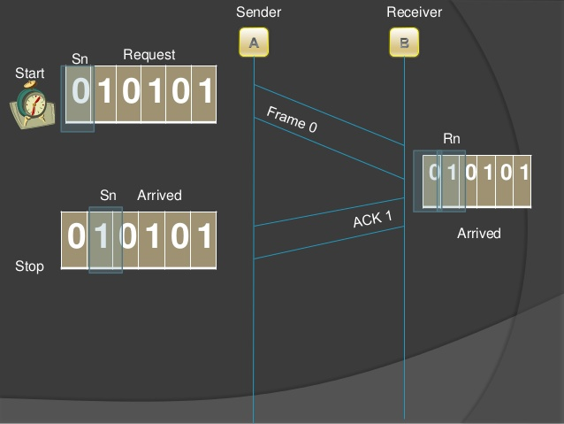

Slide 8
CASE 2
Sender Send Frame 0 To The Destination And Simultaneously Timer Is Started.
Frame 0 Is Lost Before Reaching The Destination.
Since Destination Didn’t Receive Frame 0 No Acknowledgement Is Sent.
Eventually Timer For Frame 0 Expires And Sender Resend Frame 0.
This Process Continues Until It Reaches Acknowledgement For Frame 1.
See The Animation In The Next Slide For Better Understanding.

Slide 9
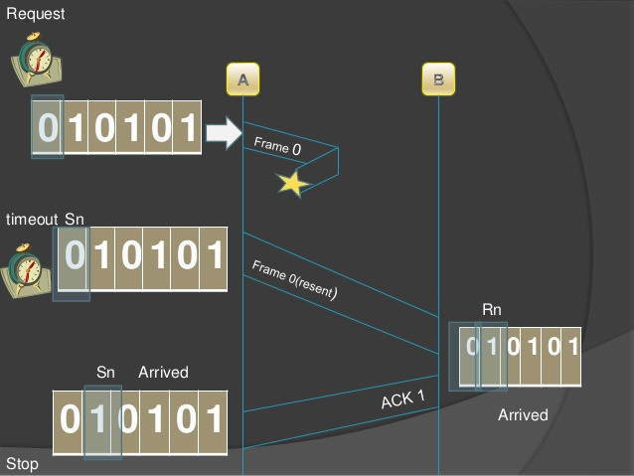

Slide 10
CASE 3
Sender Send Frame 0 To Destination And Simultaneously Time Is Started.
The Destination Accepts The Frame Since It Was Expecting Frame 0.
Now The Receiver Window Slides One Position Ahead.
Receiver Sends On Acknowledgement ACK 1 Informing The Sender That It Has Successfully Received Frame 0 And Is Expecting For Frame 1.
The Acknowledgement Gets Lost And It Doesn’t Reach The Sender.
Eventually Timer For Frame 0 Expires And Sender Resend Frame 0.
Now Since The Receiver Is Expecting For Frame 1,it Will Safely Discard The Frame 0 And Once Again Sends Acknowledgement ACK 1.

Slide 11
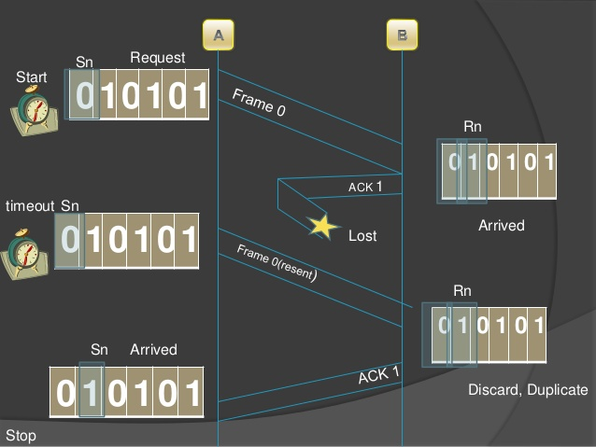

Slide 12
ADVANTAGES OF STOP AND WAIT ARQ
It Can Be Used For Noisy Channels.
It Has Both Flow And Error Control Mechanism.
It Has Timer Implementation

Slide 13
DISADVANTAGES OF STOP AND WAIT ARQ.
Efficiency Is Very Less.
Only One Frame Is Sent At A Time.
Timer Should Be Set For Each Individual Frame.
No Pipeline.
Sender Window Size Is One (Disadvantage Over Go Back And ARQ).
Receiver Window Size Is One (Disadvantage Over Selective Repeat ARQ)

